Slide 1
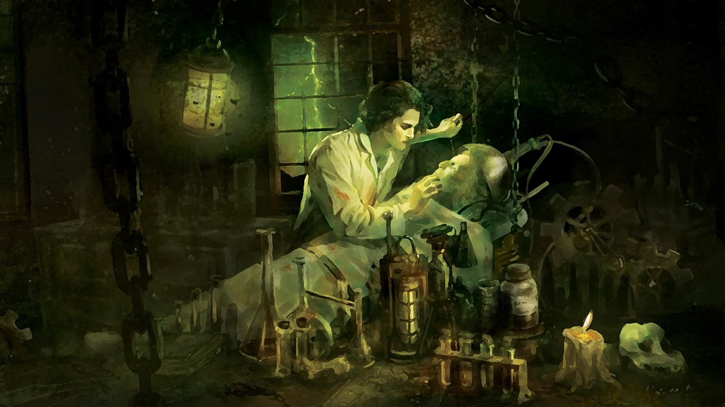
Frankenstein
A Review Game

Slide 2
What literary movement frequently involves nature, travel, folklore, self-education, and legends?

Slide 3
Answer:
Romanticism

Slide 4
In Gothic literature, the men tend to be…

Slide 5
Answer:
Insane

Slide 6
In Gothic literature, the women tend to be passive as well as…

Slide 7
Answer:
Dead (or dying)
Beautiful

Slide 8
This is a sub-genre of Romanticism where the setting occurs in creepy, far-away places; has supernatural characters; haunted houses; castles; darkness; death; secrets; and curses.

Slide 9
Answer:
Gothic

Slide 10
Which myth is Frankenstein paralleled?

Slide 11
Answer:
Prometheus

Slide 12
How old was Mary Shelley when she wrote Frankenstein?

Slide 13
Answer:
18 years old

Slide 14
Who proposed the idea to write the best ghost story which lead to the creation of Frankenstein?

Slide 15
Answer:
Lord Byron

Slide 16
Which style of writing (Romantic/Gothic) values emotions over logic?

Slide 17
Answer:
Gothic

Slide 18
What do Walton and the creature have in common?

Slide 19
Answer:
They both want a friend/companion

Slide 20
Which 2 characters share a violent obsession with knowledge that can/will lead to their destruction?

Slide 21
Answer:
Walton and Victor

Slide 22
What do Walton and Victor do that adhere to the ideals of Romanticism?

Slide 23
Answer:
Travel
Self-educated
Love/find solace in nature

Slide 24
How does Victor’s first experience with lightning act as a turning point in his life?

Slide 25
Answer:
Inspires him and has him dive deeper into his studies.

Slide 26
Henry and Victor are what type of characters?

Slide 27
Answer:
Foil Characters

Slide 28
What type of irony is used when Victor says, “A human being in perfection ought always to preserve a calm and peaceful mind, and never to allow passion or a transitory desire to disturb his tranquility”?

Slide 29
Answer:
Dramatic Irony

Slide 30
Other than lightning striking the tree, what inspires Victor to create his “monster”?

Slide 31
Answer:
His mother, Caroline, died

Slide 32
What type of savage is Victor’s creation?

Slide 33
Answer:
Noble Savage

Slide 34
After Victor recovers from his first mental breakdown, his professors talk about how great he is in his studies. This makes Victor miserable, but they think he’s being modest. What type of irony is used here?

Slide 35
Answer:
Dramatic Irony

Slide 36
Why does Justine confess to William’s murder if she is innocent?

Slide 37
Answer:
She was bullied into it

Slide 38
Justine is symbolic for what in the novel?

Slide 39
Answer:
Justice, or lack thereof

Slide 40
Justine received an unfair trial; what was used as evidence against her?

Slide 41
Answer:
The locket with Caroline’s picture

Slide 42
What type of irony is used when Victor says, “…extinguish the life I had so thoughtlessly bestowed”?

Slide 43
Answer:
Verbal Irony

Slide 44
What is ironic about the creature viewing the DeLacey family as superior beings?

Slide 45
Answer:
He is actually a superior being

Slide 46
What does the creature’s development before the DeLacey family parallel?

Slide 47
Answer:
Biblical Creation

Slide 48
Fire is symbolic for_________?

Slide 49
Answer:
Humanity

Slide 50
Lightning is symbolic for ___________?

Slide 51
Answer:
Illumination
Inspiration
Creation

Slide 52
Between fire and lightning, which represents evil/destruction?

Slide 53
Answer:
Fire

Slide 54
What type of irony is used when Safie’s father doesn’t want her to marry Felix, a Christian?

Slide 55
Answer:
Situational Irony

Slide 56
What type of irony is used when we know from the very beginning that Elizabeth is going to die?

Slide 57
Answer:
Tragic Irony

Slide 58
Why does the creature want to learn how to read and speak before Safie?

Slide 59
Answer:
He is jealous

Slide 60
What is the symbolic value of the differences between the creature and Adam?

Slide 61
Answer:
Adam represents all the good in humanity (appearance) while the creature represents all the bad (his actions/appearance)

Slide 62
What does Victor mean when he says, “But I am a blasted tree; the bolt has entered my soul; and I felt then that I should survive to exhibit what I shall soon cease to be—a miserable spectacle of wrecked humanity, pitiable to others, and intolerable to myself”?

Slide 63
Answer:
He is no longer the man he used to be; he is ruined

Slide 64
How do the Orkney Islands symbolize Victor’s mood/state of being?

Slide 65
Answer:
It is barren and isolated/remote, just like him

Slide 66
The storm on Victor and Elizabeth’s wedding night uses what literary device?

Slide 67
Answer:
Foreshadowing—Predicts Elizabeth’s death

Slide 68
How does Victor feel about his creation based on the following quote: “may be hunted like the chamois, and destroyed as a beast of prey”?

Slide 69
Answer:
He sees the creature as an animal

Slide 70
What type of irony is used when Victor says “…how ignorant are thou in thy pride of wisdom”?

Slide 71
Answer:
Dramatic Irony

Slide 72
What are the themes of the novel?

Slide 73
Answer:
Knowledge for good or evil purposes
The desire for companionship
The power of nature
Justice
Nature vs. Nurture

Slide 74
What is Gothic about the setting at the very start of the novel during Walton’s letters?

Slide 75
Answer:
It is on the way to the Arctic which is untraveled and far away

Slide 76
The majority of the novel uses what type of literary device?

Slide 77
Answer:
Flashback

Slide 78
In Gothic literature, the characters are often unbelievable. Which unbelievable trait does Victor possess?

Slide 79
Answer:
Unusually intelligent

Slide 80
In Gothic literature, the characters are often unbelievable. Which unbelievable trait does Elizabeth possess?

Slide 81
Answer:
Supernaturally beautiful

Slide 82
In Gothic literature, the characters are often unbelievable. Which unbelievable trait does the creature possess?

Slide 83
Answer:
Unusually strong

Slide 84
How is Victor a modern Prometheus?

Slide 85
Answer:
Giving man forbidden knowledge--Prometheus gave man fire; Victor creates life from death/learns the secret of life
Creating mankind from clay

Slide 86
What method of science did Victor use to give “life” to his creature?

Slide 87
Answer:
Galvanism

Slide 88
What offers healing, escape, and happiness?

Slide 89
Answer:
Nature (A very Romantic view)

Slide 90
What type of character is Victor?—Be specific

Slide 91
Answer:
Dynamic—he changes
Round—we know a lot about him/his life

Slide 92
What type of character is Walton?—Be specific

Slide 93
Answer:
Dynamic—he changes

Slide 94
What is it called when nature imitates the emotions of one or more characters in the story at that very moment in time?

Slide 95
Answer:
Pathetic Fallacy

Slide 96
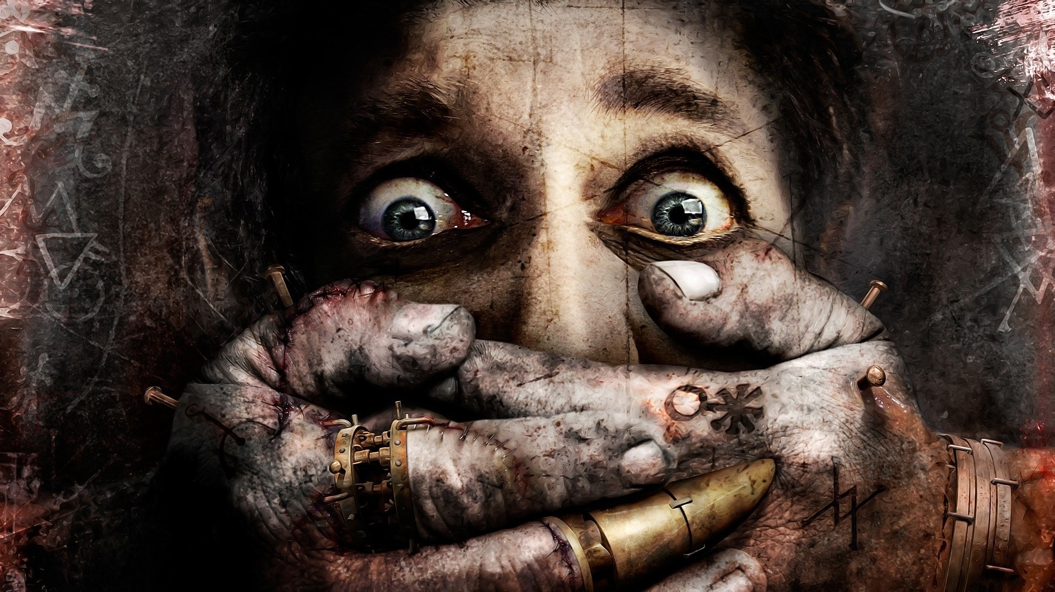
Don’t forget to
study your
vocabulary words!

Slide 97
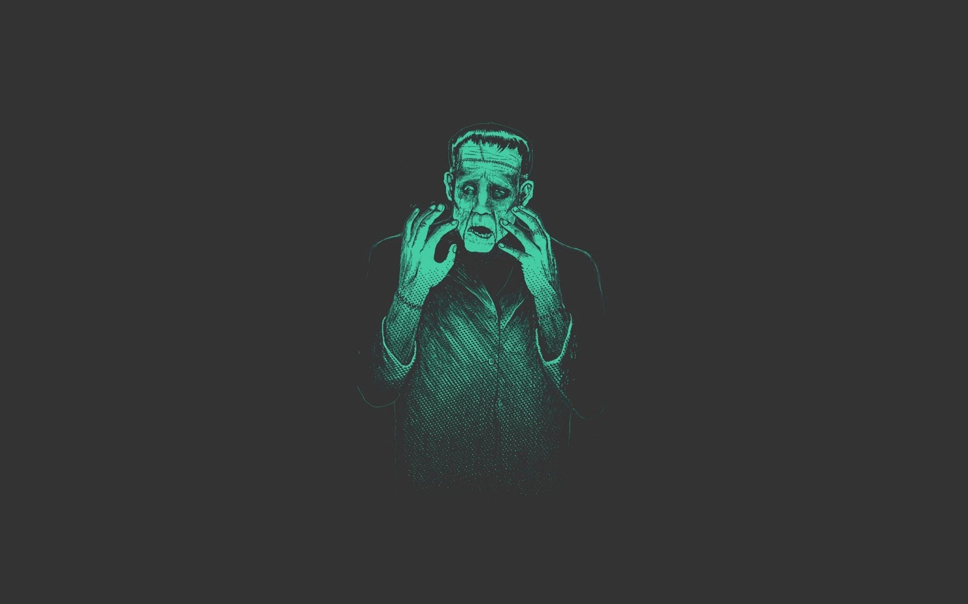
Good
Luck

