Slide 1
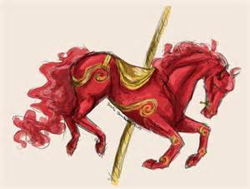
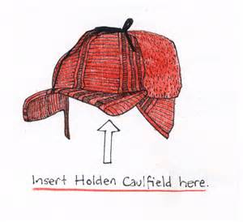
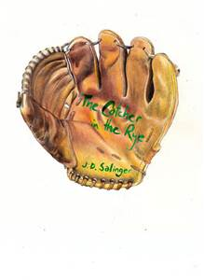
Catcher in the Rye
Review Game

Slide 2
Holden’s red hunting hat is a symbol for what 2 things?

Slide 3
Answer:
Protection from the “phony” adult world
Link to the innocent world of Allie and Phoebe (since they have red hair)

Slide 4
Baseball is a symbol for what 2 things?

Slide 5
Answer:
A link to Allie
Holden’s fear of change

Slide 6
What is Allie’s baseball mitt symbolic of?

Slide 7
Answer:
It is a tool for a “catcher” which is what Holden wants to be—for children
It is covered in poetry which explains—partly—why Holden didn’t fail
A link to Allie

Slide 8
What do the ducks represent (about 2 things)?

Slide 9
Answer:
Symbolize loss (Dealing with losing Allie)
Symbolize escape
Shows that not all change is permanent

Slide 10
What is the symbolism behind the title Catcher in the Rye?

Slide 11
Answer:
In baseball, a catcher is the only one to face his own teammates; therefore, Holden remains outside society’s norm by rejecting adulthood.
Holden wants to protect children from adulthood/death

Slide 12
Why does Holden want to protect children so badly?

Slide 13
Answer:
Holden feels he must protect children because he could not protect Allie.

Slide 14
What is the significance of the following quote?
“All the kids kept trying to grab for the gold ring, and so was old Phoebe, and I was sort of afraid that she’d fall off the …horse, but I didn’t say anything or do anything. The thing with kids is, if they want to grab for the gold ring, you have to let them do it, and not say anything. If they fall off, they fall off, but it’s bad if you say anything to them.”

Slide 15
Answer:
Holden realizes that children must grow up and do things on their own.

Slide 16
What do Holden’s fantasies serve as?

Slide 17
Answer:
They serve as an escape; a way for Holden to cope with his emotions.

Slide 18
What is the meaning of the following quote?
Holden: “Oh…well, about Life being a game and all. And how you should play according to the rules…He just kept talking about Life being a game and all. You know.”
Mr. Spencer: “Life is a game, boy. Life is a game that one plays according to the rules.”

Slide 19
Answer:
Mr. Spencer tells Holden that he must conform to societal norms in order to succeed.

Slide 20
What is the meaning of the following quote?
Phoebe: “Name one thing you like…You like a lot…Name something you’d like to be.”

Slide 21
Answer:
Phoebe wants Holden to be happy and shows that she cares for her brother’s well-being.

Slide 22
What bothers Holden about Sunny the most?

Slide 23
Answer:
She is so young, and he thinks she should be kept safe. He is unnerved that the adult world is overlapping the young world.

Slide 24
What makes Holden an unreliable narrator?

Slide 25
Answer:
He lies to himself, others, and the audience as well as has bias (the adult world is “phony.”)

Slide 26
Holden likes the Museum of Natural History because nothing inside changes. He, however, refuses to go inside despite his fond memories. Why?

Slide 27
Answer:
He is unwilling to see how much he’s changed since his last visit.

Slide 28
What type of savage is Holden?

Slide 29
Answer:
Noble Savage

Slide 30
Holden’s behavior is extreme throughout the novel. What is the significance of his impulsiveness?

Slide 31
Answer:
He has intense feelings of captivity in a world he cannot relate. He feels he must do something rash in order to get somewhere.

Slide 32
Holden gives Phoebe pieces of the broken record he bought for her. What is significant about her keeping these pieces?

Slide 33
Answer:
It demonstrates that she accepts Holden--including his flaws.

Slide 34
Holden wakes up to Mr. Antolini petting his head. Holden freaks out and runs away. What is the significance of his intense reaction?

Slide 35
Answer:
He feels violated by the adult world again.

Slide 36
The poem “Comin’ Thro’ the Rye” is actually about what?

Slide 37
Answer:
Casual Sex

Slide 38
What is the significance about a little boy reciting “Comin’ Thro’ the Rye”?

Slide 39
Answer:
It shows that the world is tinged with sex (even in childhood).

Slide 40
Which themes are shown with Allie’s death?

Slide 41
Answer:
The loss of innocence/
Anger as a shield against pain

Slide 42
Which theme is shown when Holden breaks his hand by breaking all the windows in the garage when he learns of Allie’s death?

Slide 43
Answer:
Anger as a shield against pain

Slide 44
Which theme is shown every time Holden puts on his red hunting hat?

Slide 45
Answer:
Alienating oneself as a form of protection

Slide 46
Which theme is shown throughout the novel as Holden refuses to “grow up”?

Slide 47
Answer:
Loss of Innocence

Slide 48
Which theme is shown when Holden daydreams/talks to Allie saying that he can play with him and his friends this time?

Slide 49
Answer:
Guilt for sins/crimes

Slide 50
What theme is shown with Holden’s reaction to Mr. Antolini petting him while he’s sleeping?

Slide 51
Answer:
Disgust with Hypocrisy of the Adult World

Slide 52
The cliff in Holden’s fantasy is symbolic of what 2 things?

Slide 53
Answer:
Adulthood
Death

Slide 54
Who can the reader infer is the audience Holden is speaking to?

Slide 55
Answer:
A psychoanalyst
A doctor in the hospital he is in

Slide 56
When Phoebe tries to run away with Holden, he decides to stay. This is a turning point for Holden for which 2 reasons?

Slide 57
Answer:
He finally registers a connection with someone
He becomes aware that he must be the “adult” and stay for his sister.

Slide 58
What is the significance of Holden saying the word grand is phony and not Mr. Spencer (the one who says it)?

Slide 59
Answer:
It shows his respect for Mr. Spencer

Slide 60
Why does Holden believe D.B. is a prostitute?

Slide 61
Answer:
He writes movies, instead of his own stories, for a living

Slide 62
What is the significance of keeping Jane from making an appearance in the novel?

Slide 63
Answer:
Exaggerates Holden’s difficulty with women and inability to connect

Slide 64
What is the significance of keeping Holden’s father from making an appearance in the novel?

Slide 65
Answer:
Exaggerates how cut off he is from Holden emotionally (by choice)

Slide 66
Why does Holden decide to leave Pencey Prep early?

Slide 67
Answer:
He feels overwhelmed and panicked about his expulsion

Slide 68
Why does Holden dislike fist fights/war?

Slide 69
Answer:
He cannot stand the thought of causing pain to another human

Slide 70
What were the feelings in Post-WWII America that are depicted in the novel?

Slide 71
Answer:
Cruel
Isolation
Chaos

Slide 72
What is gained by telling the story in first person?

Slide 73
Answer:
We get a better understanding of Holden and develop empathy for him because of this.

Slide 74
What is the significance of Holden constantly repeating himself?

Slide 75
Answer:
He is trying to convince himself of what he said

Slide 76
What do the fish in Central Park’s lagoon symbolize?

Slide 77
Answer:
Holden and how he has to stay in his environment

Slide 78
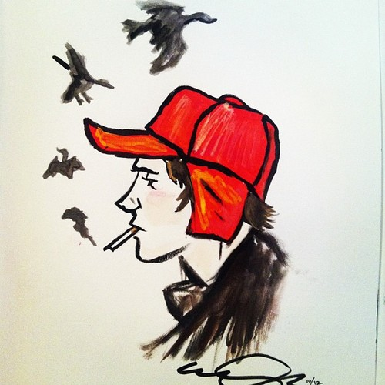
Alright, ya phonies. You will have a vocabulary section, so be sure to study those words you received at the start of the novel.

